Slide 1
“Why do parents make their children work?” by Christelle Dumas
Chien Yu (Sophia) Yeh

Slide 2
Introduction
Previous studies
1. Becker (1991)’s theory of education demand: child labor may be the optimal response to a trade-off between returns to and costs of education.
2. The impact of constraints on the household labor supply. Some articles show that adults labor market imperfection (Bhalotra & Heady, 2003), poverty (Basu and Van, 1998), or credit market imperfections (Jacoby & Skoufias, 1997; Ranjan, 1999; parker & Skoufias, 2002; Baland & Robinson, 2000) can favor child labor.

Slide 3
Introduction
Poverty hypothesis: child labor is due to parent’s poverty. Parents value child leisure but if they are poor thy may not be able to afford it.
Null hypothesis: Child labor is caused by the absence of labor market.

Slide 4
1. Poverty hypothesis literature review
Poverty Hypothesis:
“Strong” version: The preferences of the parents towards child leisure are such that they send them to work if (and only if) their income is below a subsistence consumption threshold.
“Weak” version: Above the subsistence level, parents trade off between child leisure and consumption of the whole household.

Slide 5
1. Poverty hypothesis literature review
The “subsistence hypothesis” (the assumption that parents do not make their children work once a subsistence level is reached) → if its true, it suggests that an “easy” way of eradicating child labor would be to redistribute money to poor households in order for them to reach subsistence.
The “hypothesis of luxury” (child leisure is a luxury good) → It suggests that eradicating child labor through redistribution would cost less to the government than if it were just a normal good, but it would cost much more than if it was just a matter of reaching the subsistence level.

Slide 6
2. The ICRISAT Burkina Faso dataset
Burkina Faso farm household survey conducted by the International Crops Research Institute for the Semi Arid Tropics (ICRISAT).
Five year panel study (1981-1985) of 150 households in six villages belonging to three different agro-climatic zones of Burkina Faso.
The study uses mainly data from the first three years of the survey (1981-1983).
Enumerators visited the sample households approximately every 10 days to collect information on farm operations, inputs and outputs of the household’s plots since the previous visit.
Worker’s categories: children below ten, male adults and female adults (above ten) and non-household workers).

Slide 7
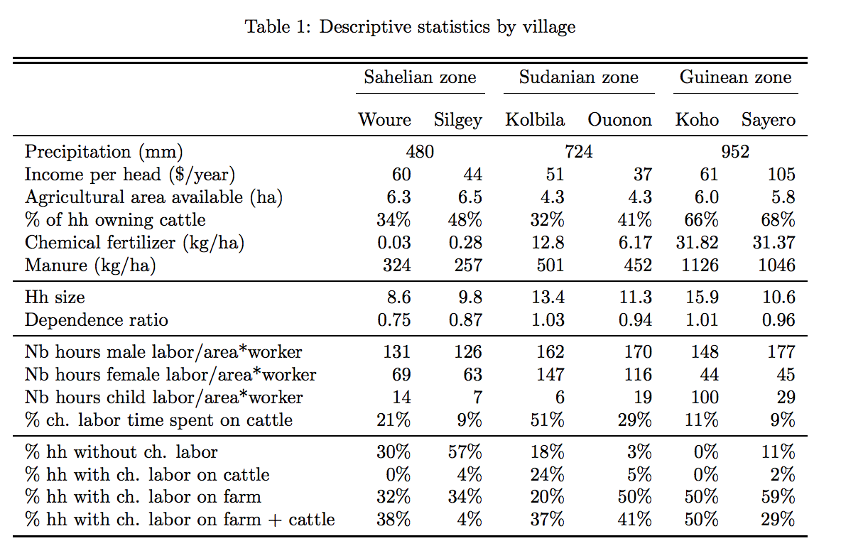
2.2 Descriptive statistics by village

Slide 8
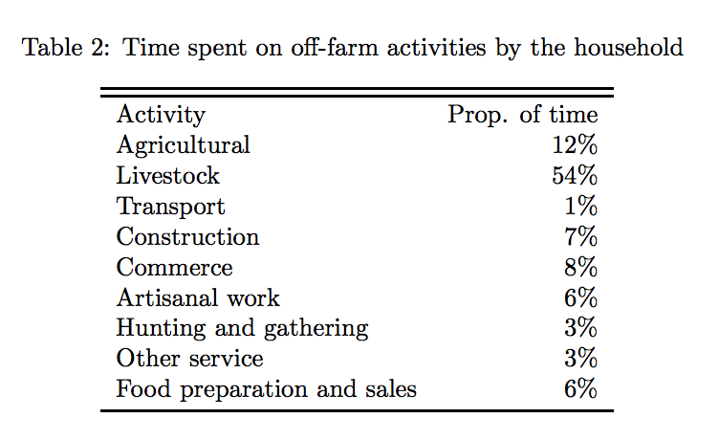
2.3.1 Off-farm activities

Slide 9
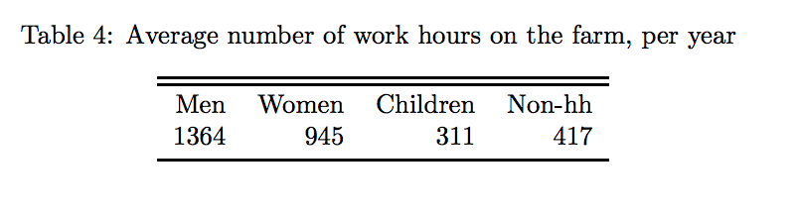
2.3.2 Labor market imperfections

Slide 10
3.1 Theoretical framework: rural households without market labor
In the absence of labor market, consumption decisions depend of the production side and vice-versa.
Assumption 1: No labor market.
Assumption 2: Households do not choose the quantity and quality of land they own.
Assumption 3: Households live only with the income generated by land farming.

Slide 11

3.2 Production function specification
We assume the following Cobb-Douglas production function, where one of the input is a labor aggregate:

Slide 12

3.3 Utility function specification
Specific utility function. For a household with a single parent and a single child:
where C is the household’s consumption, La adult leisure and Lc child leisure

Slide 13
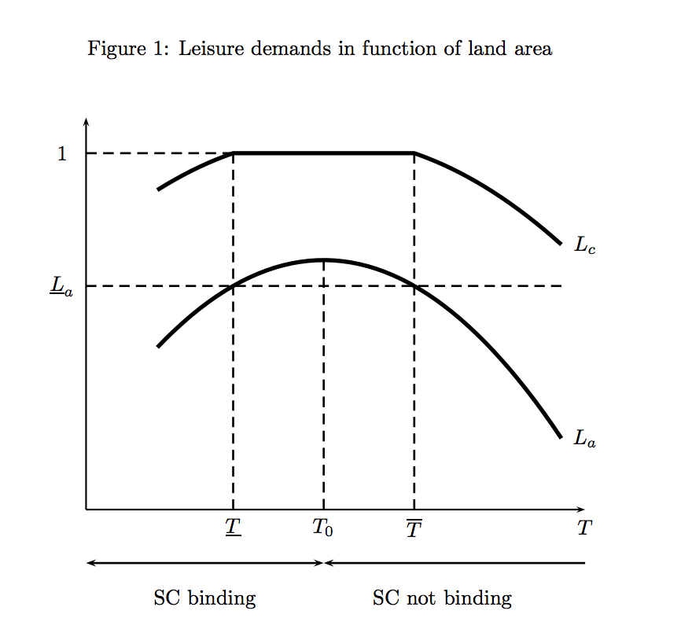
3.4 Child and adult leisure demands

Slide 14
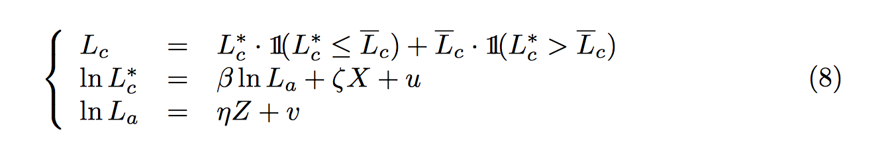
4 Empirical implementation

Slide 15
5. Possible extensions of the analysis
Testing the assumption of perfect substitutability be- tween child and adult labor
Relaxing the specification of utility function
Relaxing the assumption of absence of labor market
Relaxing the assumption of absence of other economic activities
Adding schooling opportunities

Slide 16
Conclusion
Children provide labor because of market imperfection and not because of household subsistence needs.
Child leisure is a normal good.

